Slide 1
Lecture 25
Software Configuration Management
Muhammad Qasim

Slide 2
Software Configuration Management
A set of management disciplines within a software engineering process to develop a baseline
Software Configuration Management encompasses the disciplines and techniques of initiating, evaluating and controlling change to software products during and after a software project

Slide 3
Configuration Management Activities
Software Configuration Management Activities:
  Configuration item identification
    Modeling the system as a set of evolving components
  Promotion management
    the creation of versions for other developers
  Release management
    the creation of versions for clients and users
  Change management
    the handling, approval & tracking of change requests
  Branch management
    the management of concurrent development
  Variant management
    the management of coexisting versions
No fixed order:
  These activities are usually performed in different ways (formally, informally) depending on the project type and life-cycle phase (research, development, maintenance).

Slide 4
Configuration Management Roles
Configuration Manager
  Responsible for identifying configuration items
  Also often responsible for defining the procedures for creating promotions and releases
Change Control Board Member
  Responsible for approving or rejecting change requests
Developer
  Creates promotions triggered by change requests or the normal activities of development. The developer checks in changes and resolves conflicts
Auditor
  Responsible for the selection and evaluation of promotions for release and for ensuring the consistency and completeness of this release.

Slide 5
Terminology
We will define the following terms
  Configuration Item
  Baseline
  SCM Directories
  Version
  Revision
  Release

Slide 6
Terminology:
Configuration Item (CI): “Anything uniquely identifiable that can be changed independently.”
Examples of CIs include individual requirements documents, software, models, and plans.
Version: The initial release or re-release of a configuration item associated with a complete compilation or recompilation of the item. Different versions have different functionality.
Baseline: “A specification or product that has been formally reviewed and agreed to by responsible management, that thereafter serves as the basis for further development, and can be changed only through formal change control procedures.”
Promotion: The internal development state of a software is changed. e.g.; sprint1, 2 etc
Release: A changed software system is made visible outside the development organization.

Slide 7
Terminology: SCM Directories
Programmer’s Directory (IEEE: Dynamic Library)
  Library for holding newly created or modified software entities
  The programmer’s workspace is controlled by the programmer only
Master Directory (IEEE: Controlled Library)
  Manages the current baseline(s) and for controlling changes made to them
  Changes must be authorized
Software Repository (IEEE: Static Library)
  Archive for the various baselines released for general use
  Copies of these baselines may be made available to requesting organizations.

Slide 8
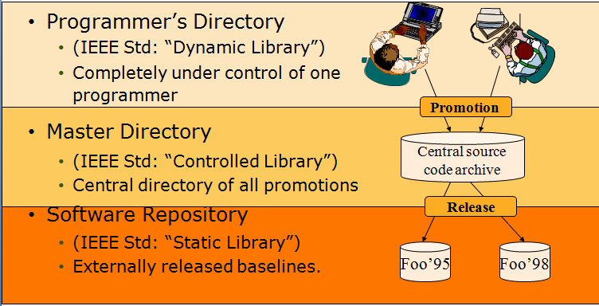
Standard SCM Directories

Slide 9
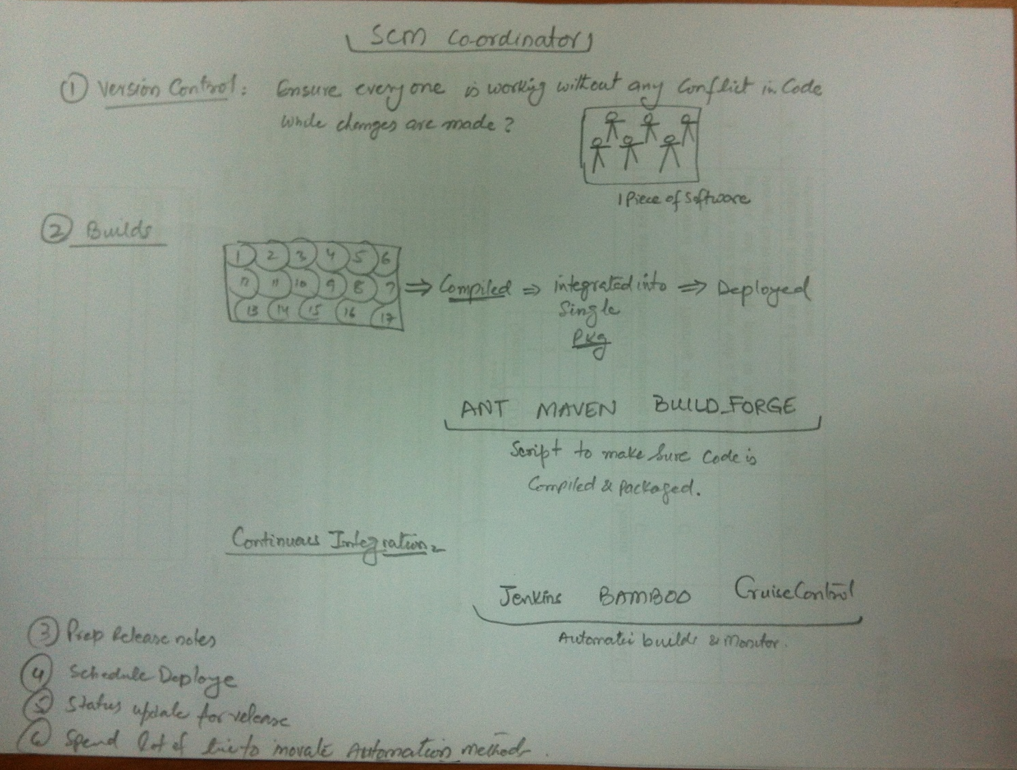
Configuration Management in Real life

Slide 10
Tools
RCS
CVS
Subversion

